Slide 1
CAPSTONE PROJECT
TEAM - 1
TEAM MEMBERS:
Vishnu Sathyan
Arjun Shilin
Augustine
Mohammad Faiz
Parvathy Madhu
Aryamol Ashokan

Slide 2
TABLE OF CONTENTS
01
02
03
04
05
DOCUMENT/ppt CREATION
protractor
selinium
integration
Jenkins+GIT
Write test plan, test strategy ,test case for deals of the week
module in urbanladder and créate ppt’s for
Mockito,grafana,
zephyr
Test the module deals of the week using protractor
Selenium web driver testcases to locate the elements of Urban ladder webpages. To depict the wait, sleep during the implementation
Cucumber + TestNG + Selenium integration to test the module of urban ladder. To imbibe the lighthouse or google axe tools.
Jenkins+selinium+git integration to check the module deals of the week in urban Ladder website
2

Slide 3
TABLE OF CONTENTS
06
07
08
09
10
Aws + jmeter
restassurd
MOBILE TESTING
SELINIUM + AWS
Python
Performance check for the module of urban ladder using JMeter on AWS cloud
API testing on sample spring boot application using rest assured
To depict Appium + selenium for mobile testing(Android) using emulator
Integrating aws with Jenkins and git
Selinium web driver automation testing using Python
3

Slide 4

Task 1
Click here
Write test plan, test strategy ,test case for deals of the week module in urbanladder.com
Presented by Aryamol Ashokan, Parvathy and Arjun

Slide 5
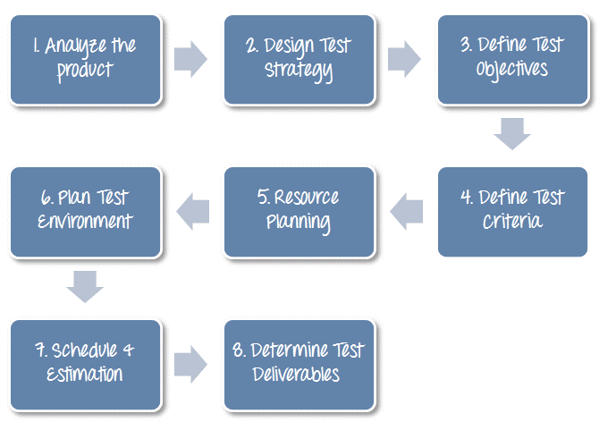
TEST PLAN
Detailed document that describes the test strategy, objectives, schedule, estimation, deliverables, and resources required to perform testing for a software product
Click here
Notes:
https://www.guru99.com/what-everybody-ought-to-know-about-test-planing.html

Slide 6
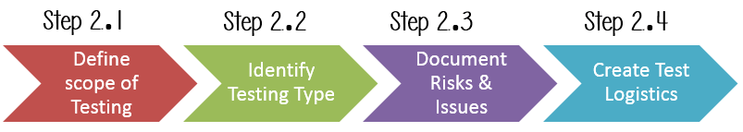
TEST STRATEGY
Well-described document in software testing which clearly defines the exact software testing approach and testing objectives of the software application.
Click here

Slide 7
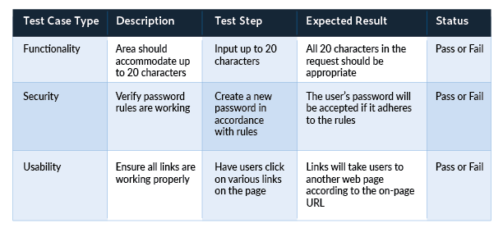
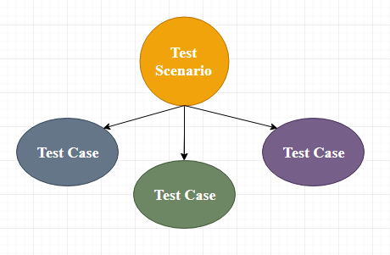
TEST CASE
Set of actions executed to verify a particular feature or functionality of the software application.
Click here

Slide 8
Task 2
Test the module deals of the week using protractor
Presented by Aryamol Ashokan

Slide 9
PROTRACTOR
Protractor is a wrapper around Selenium Web driver that provides an automation test framework, which simulates user interaction with an Angular web application
Protractor needs two files to run, a spec file and configuration file.
Configuration file: This File helps protractor to where the test files are placed (specs.js) and to talk with Selenium server (Selenium Address). Chrome is the default browser for Protractor.
Spec file: This File contains the logic and locators to interact with the application.

Slide 10
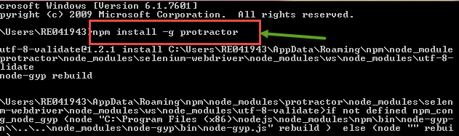

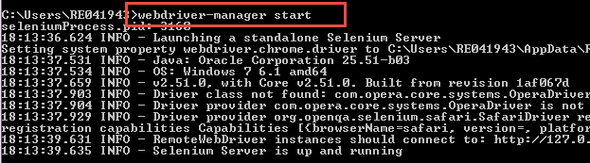
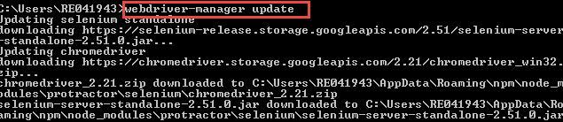
PROTRACTOR INSTALLATION
Open command prompt and type “npm install –g protractor”
Check the installation and version using “Protractor –version.”
Update the Web driver manager using the command “webdriver-manager update”
Start the Web driver manager using the command “webdriver-manager start”

Slide 11
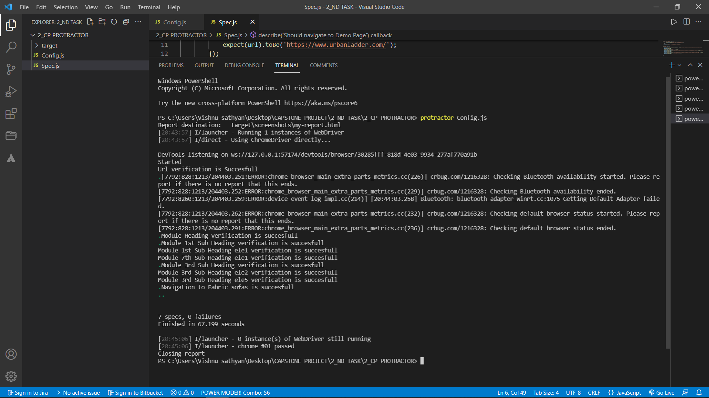

Slide 12
Task 3
Selenium web driver testcases to locate the elements of Urban ladder webpages. To depict the wait, sleep during the implementation
Presented by Mohammad Faiz

Slide 13
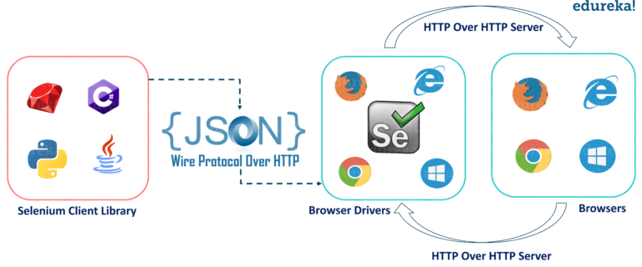
SELENIUM
Selenium is a free (open-source) automated testing framework used to validate web applications across different browsers and platforms. we can use multiple programming languages like Java, C#, Python etc. to create Selenium Test Scripts.

Slide 14
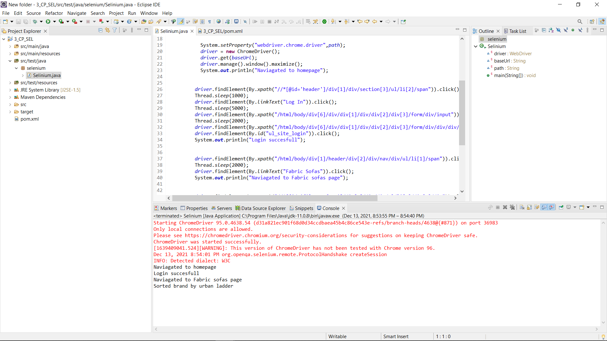

Slide 15
Task 4
Cucumber + TestNG + Selenium integration to test the module of urban ladder. To imbibe the lighthouse or google axe tools.
Presented by Mohammad Faiz

Slide 16
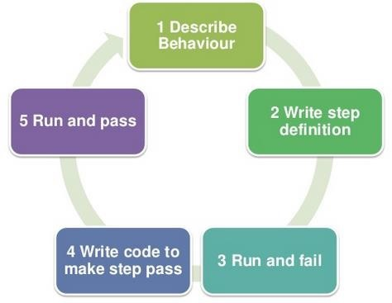
CUCUMBER
Cucumber is a software tool used by the testers to develop test cases for testing the behavior of the software.(BDD TOOL)3
In the Cucumber testing, the test cases are written in a simple English text, which anybody can understand without any technical knowledge. This simple English text is called the Gherkin language.

Slide 17
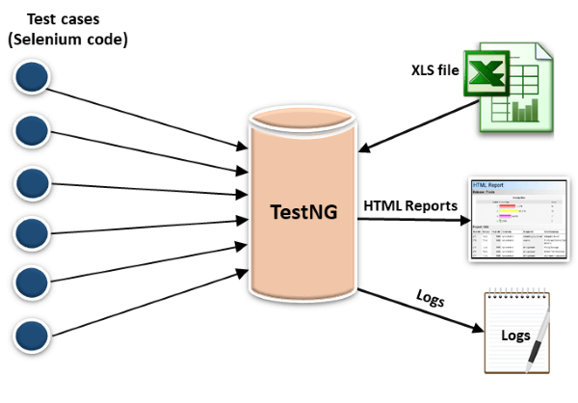
TESTNG
TestNG provides full control over the test cases and the execution of the test cases. Due to this reason, TestNG is also known as a testing framework.

Slide 18
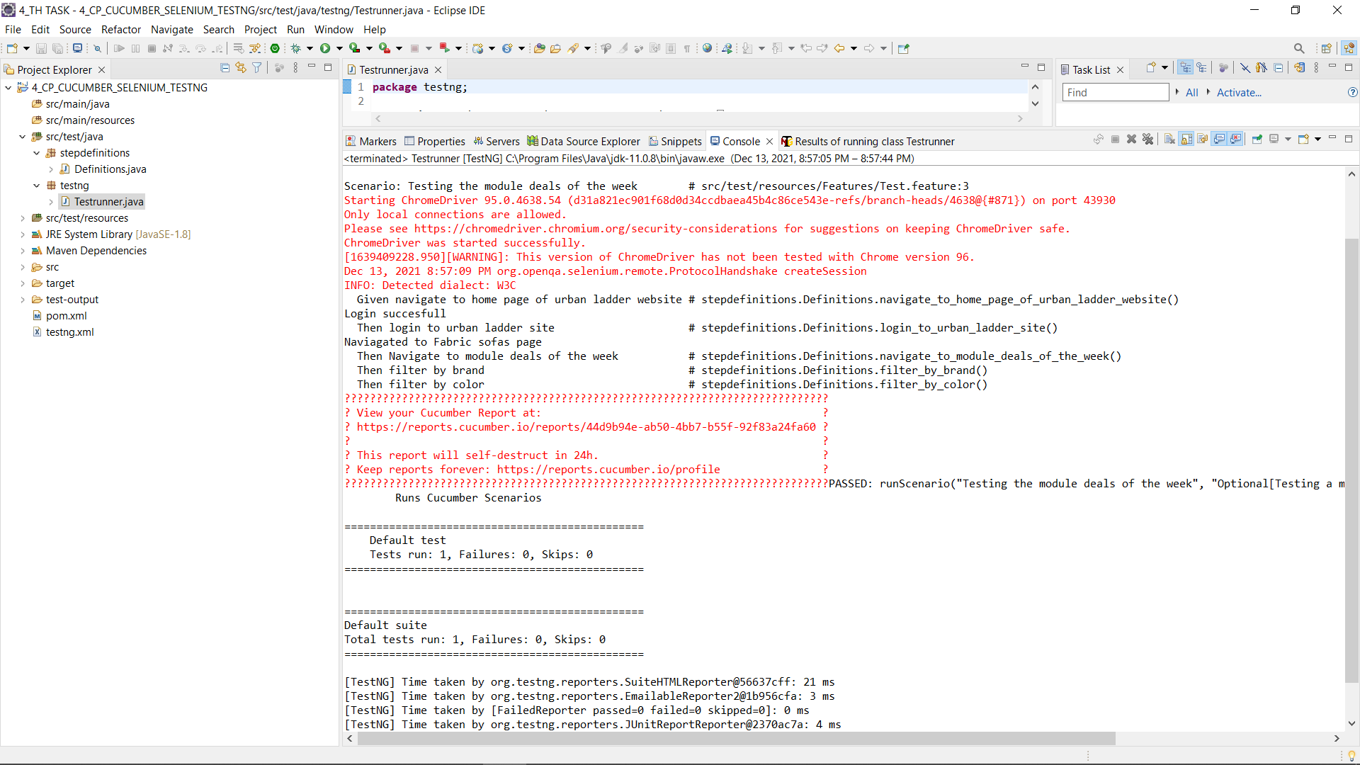

Slide 19
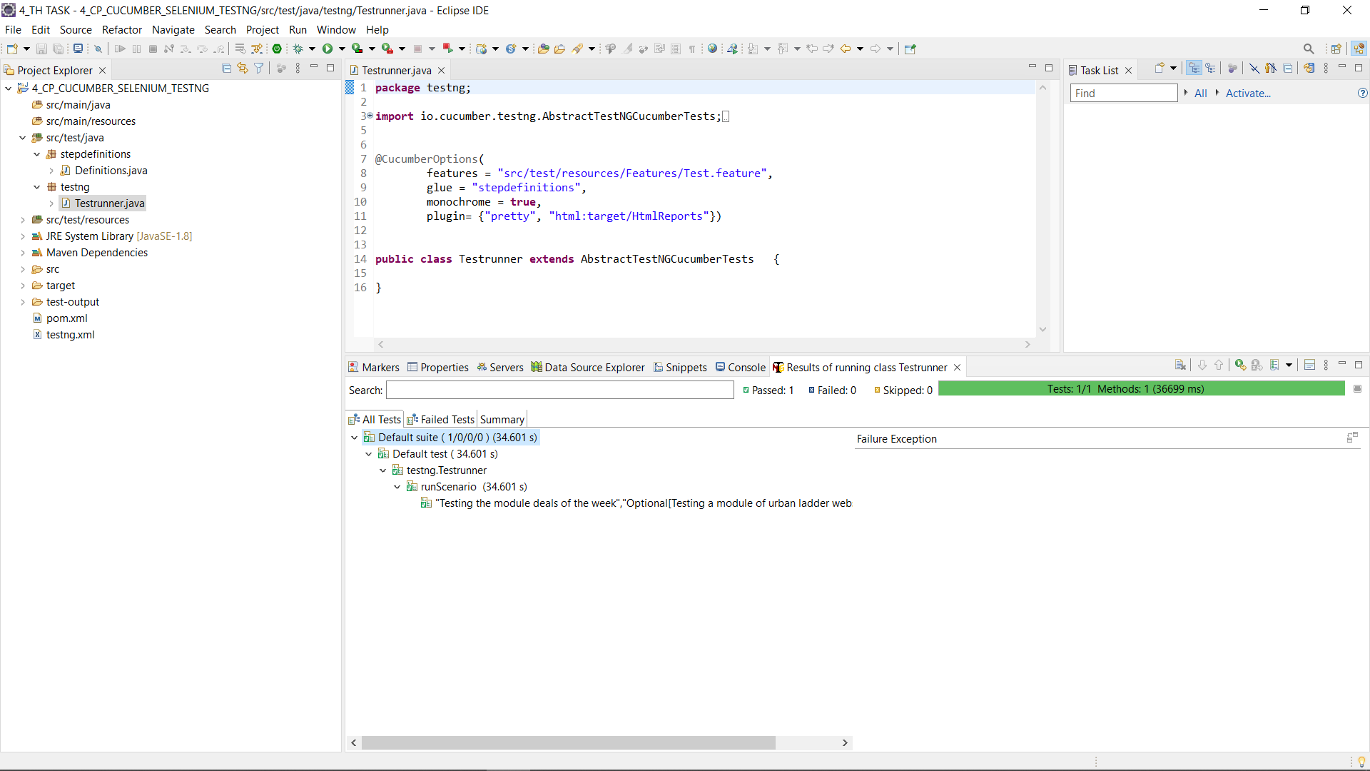

Slide 20
LIGHTHOUSE
Lighthouse is an open-source, automated tool for improving the performance, quality, and correctness of your web apps.
When auditing a page, Lighthouse runs a barrage of tests against the page, and then generates a report on how well the page did.
From here we can use the failing tests as indicators on what you can do to improve your app
It’s a browser extension
Click here

Slide 21
GOOGLE AXE TOOOLS
Axe DevTools includes tools that perform accessibility testing for web apps, native iOS and native Android.
Axe DevTools is a toolkit for finding, preventing and fixing accessibility defects in the code.
The free Chrome extension provides incredible insight into likely issues
Click here

Slide 22
Task 5
Jenkins+selinium integration to check the module deals of the week in urban Ladder website
Presented by Parvathy

Slide 23

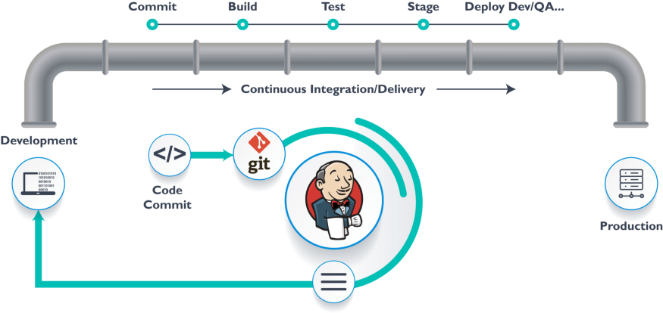
JENKINS
Jenkins is an open source continuous integration/continuous delivery and deployment (CI/CD) automation software DevOps tool written in the Java programming language. It is used to implement CI/CD workflows, called pipelines.
Click here

Slide 24
Task 6
Performance check for the module of urban ladder using JMeter on AWS cloud
Presented by Arjun

Slide 25
JMETER ON AWS
Apache JMeter is pure Java-based open-source software designed to load test functional behavior and measure performance.
JMeter can be also used to analyze and measure the performance of web applications or a variety of services.
Amazon web service is an online platform that provides scalable and cost-effective cloud computing solutions.
AWS is a broadly adopted cloud platform that offers several on-demand operations like compute power, database storage, content delivery, etc., to help corporates scale and grow
JMeter+AWS
JMeter UI

Slide 26
Task 7
API testing on sample spring boot application using rest assured
Presented by Vishnu Sathyan

Slide 27
REST ASSURED
One of the most used library for REST API Automation Testing.
Rest-Assured is a Java-based library that is used to test RESTful Web Services. This library behaves like a headless Client to access REST web services.
Rest-Assured library also provides the ability to validate the HTTP Responses received from the server
we can verify the Status code, Status message, Headers and even the Body of the response.

Slide 28
Task 8
To depict Appium + selenium for mobile testing(Android) using emulator
Presented by Vishnu Sathyan

Slide 29
APPIUM
APPIUM is a freely distributed open source mobile application UI Testing framework
Appium allows native, hybrid and web application testing and supports automation test on physical devices as well as an emulator or simulator both.
It offers cross-platform application testing, i.e. single API works for both Android and iOS platform test scripts.

Slide 30
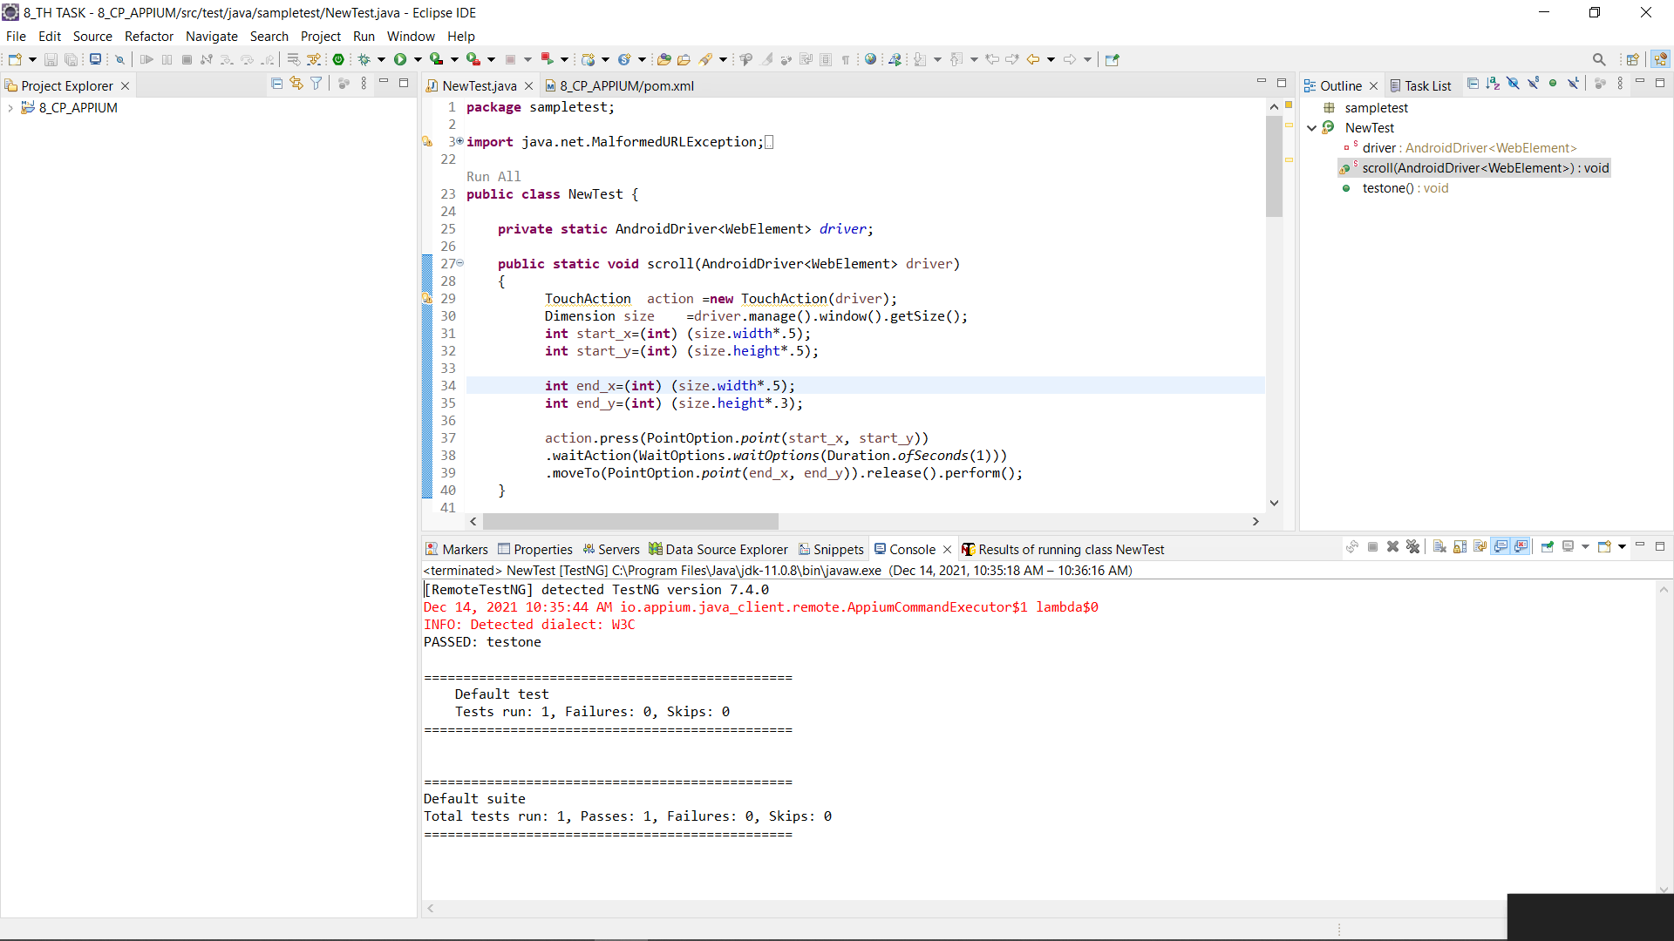

Slide 31
Task 9
Integrating AWS+JENKINS+GIT
Presented by Vishnu Sathyan
Aws +Jenkins

Slide 32
Task 10
Click here
Selinium web driver automation testing using Python
Presented by Augustine

Slide 33
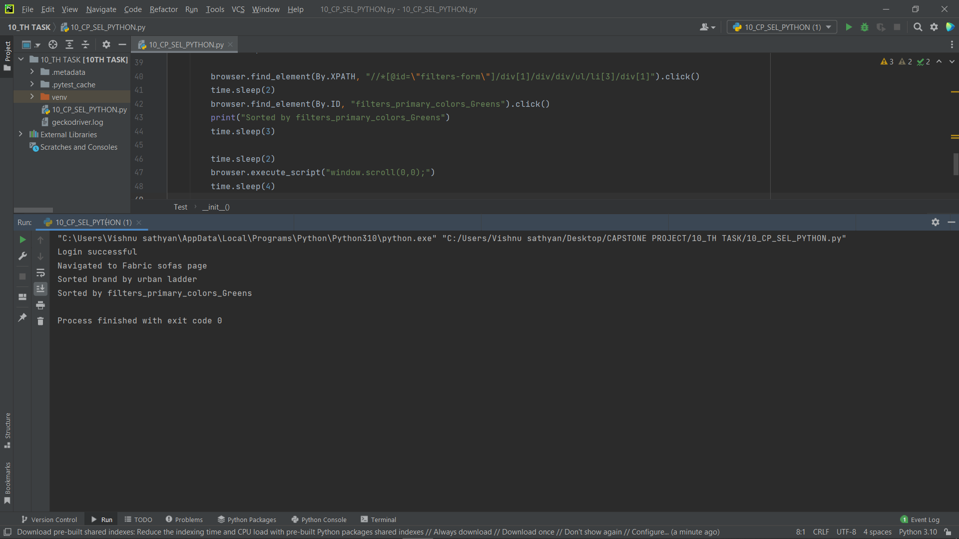

Slide 34
Reference
GitHub link to reference the code related to different tasks

Slide 35
GitHub link
Click here

Slide 36
Thank You 1

